Slide 1
Upgrading from AngularJS 1 to Angular 2+
Jake Adams

Slide 2






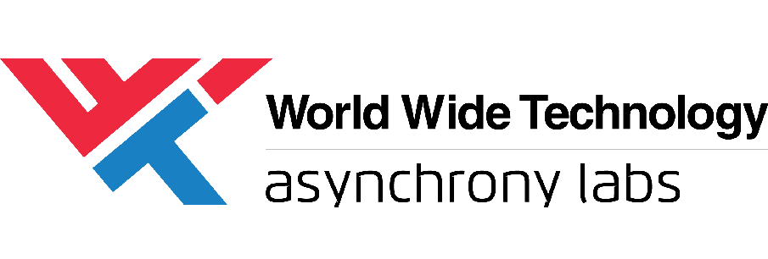











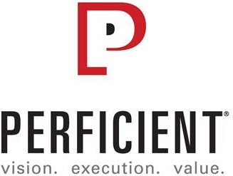


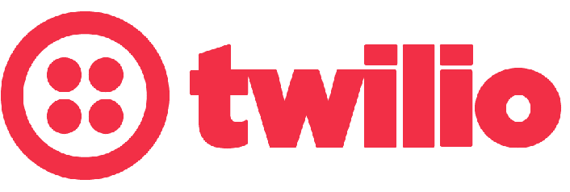




Swag Bags
Platinum Sponsors
Lanyards
Party
Gold Sponsors
Notebooks
Media

Slide 3
About Me
Jake Adams
Father / Husband
Senior Software Architect - Thompson Coburn LLP
twitter - @jacobladams
http://github.com/jacobladams

Slide 4
Overview
Why / Migration Options
Prepping for Migration
Style Guide / Best practices
TypeScript
WebPack Build
Migrating using ngUpgrade
Bootstrapping
Switching to Angular CLI
Upgrading / Downgrading Components / Service
Routing

Slide 5
Vocabulary
AngularJS vs. Angular
Upgrade vs. Update vs. Migration

Slide 6
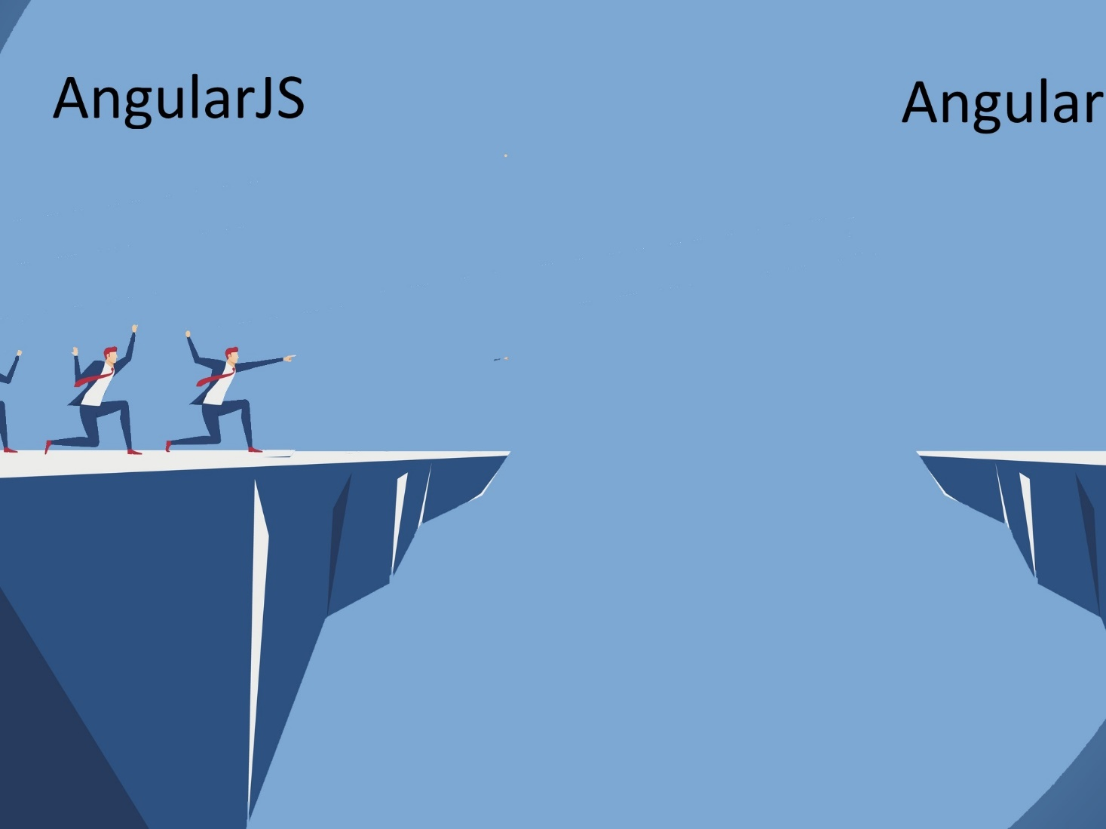

Slide 7
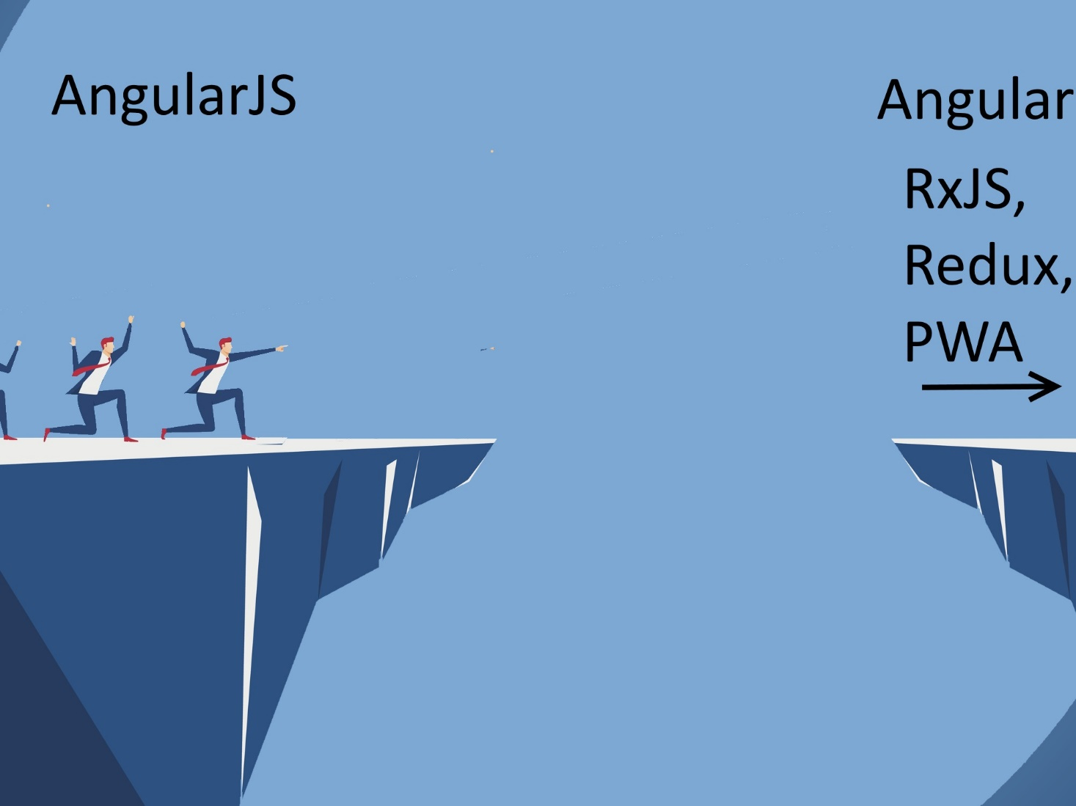

Slide 8
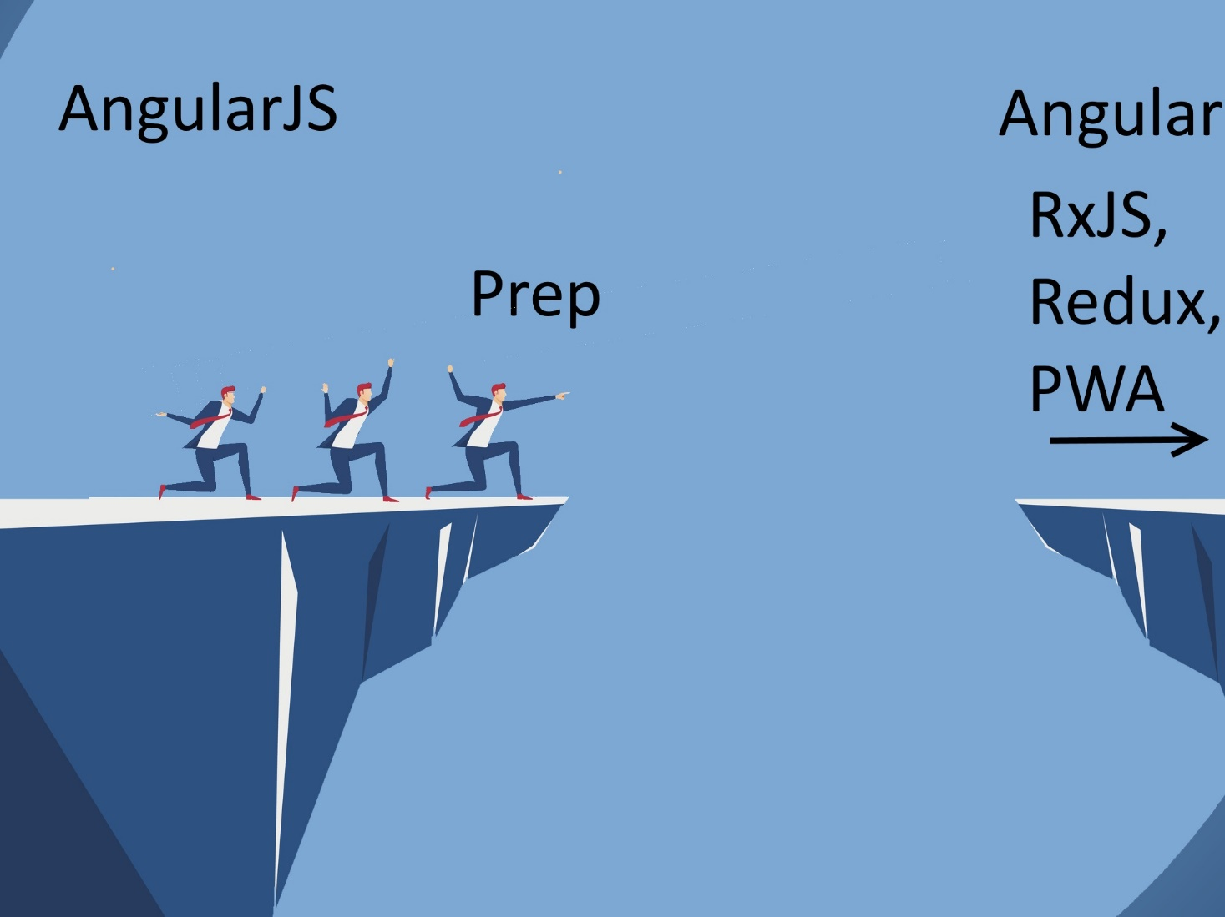

Slide 9
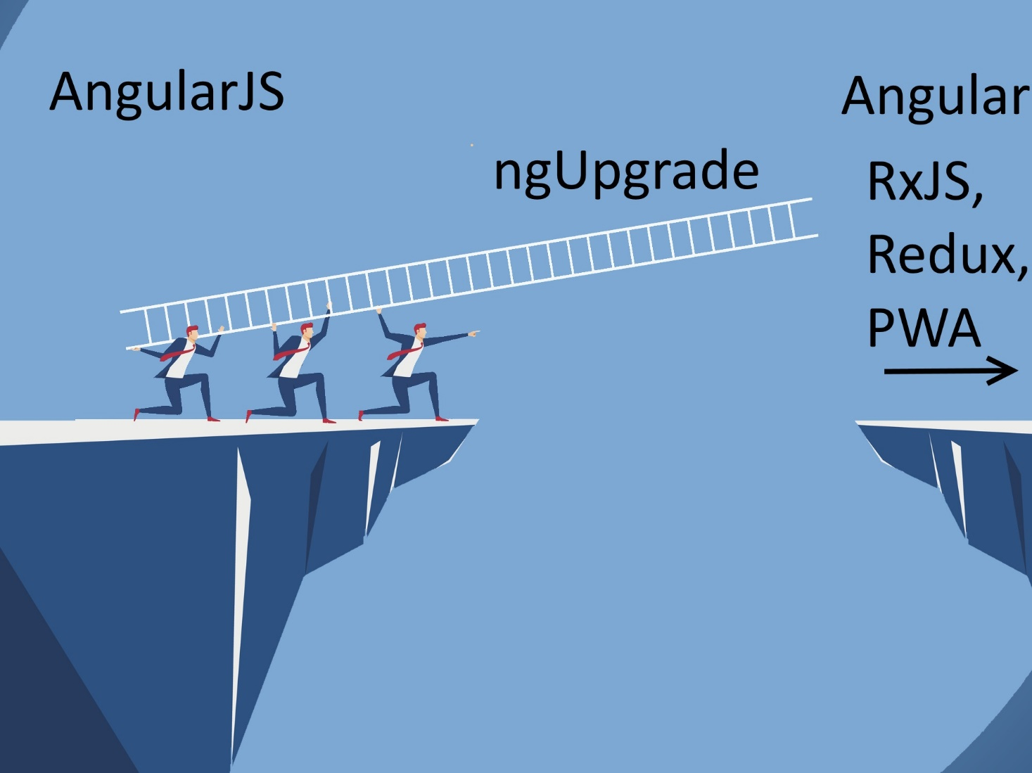

Slide 10
Why Angular 2
Faster
Simpler
Future Focused / Compliant
JavaScript Modules
Web Components
Additional Features
RxJS/Redux/NgRx
Server Side Rendering
Service Workeres / Progressive Web Apps

Slide 11
But I Don’t Want To!

Slide 12
Option #1: Stay on Angular JS 1.X
AngularJs 1.7.X
Jan 1 – June 30, 2018 – Active Development
Jul 1 2018 – June 30, 2021 Long Term Support (LTS)
On July 1st 2018, … we will focus exclusively on providing fixes to bugs that satisfy at least one of the following criteria:
A security flaw is detected in the 1.7.x branch of the framework
One of the major browsers releases a version that will cause current production applications using AngularJS 1.7.x to stop working
The jQuery library releases a version that will cause current production applications using AngularJS 1.7.x to stop working.
Related Blog Post

Slide 13
Option #2: Go to Another Framework
React
Vue
Ember
Aurelia
Knockout
Hyperapp
Polymer
Backbone

Slide 14
Ok, fine. I’ll migrate

Slide 15
Migration Options
Rewrite
ngUpgrade

Slide 16
What is ngUpgrade
Let’s Angular 1 and Angular 2+ interoperate
Provides functionality to “upgrade” and “downgrade” components and services.
Upgrade – Take Angular 1 thing and make it available in Angular 2
Downgrade – Take Angular 2 thing and make it available in Angular 1

Slide 17
Why ngUpgrade
Keeps system deployable
Reduce risk
Steady upgrade

Slide 18
Cons
Have to load both frameworks
Slower overall time

Slide 19
Demo Architecture

Slide 20
Bootstrap

Slide 21
Service

Slide 22
Angular CLI

Slide 23
Components

Slide 24
Components - 2

Slide 25
All Components and Services

Slide 26
Router

Slide 27
All Routes

Slide 28
Further Steps
RxJS
Redux
Lazy Loading
Progressive Web App (PWA)
Plenty Others

Slide 29
Additional Resources / Questions
Pluralsight couses
Preparing for Migration from AngularJS (1.x) to Angular (2+)
Migrating Applications from AngularJS to Angular
Webinar – Strategies for migrating in Angular
Angular Docs – Upgrading from AngularJS to Angular
Dor Moshe - Angular v4: Hybrid Upgrade Application
Rangle.io - Migrating Angular 1.x Projects to Angular 2

